Slide 1
MVC (and Sitecore)
2014 November 21st

Slide 2
Agenda
Background: MVP, MVC
Overview
Plain MVC
Razor, controller, model, binding, forms, extension points, dependency injection, global filters
Web API
Controller, content negotiation, dependency injection
Sitecore MVC
Controller renderings, rendering pipeline, view rendering, model, post actions
Sitecore MVC in Codehouse
Domain Model, Mappings (Glass), View rendering, Controller (Glass/repository)

Slide 3
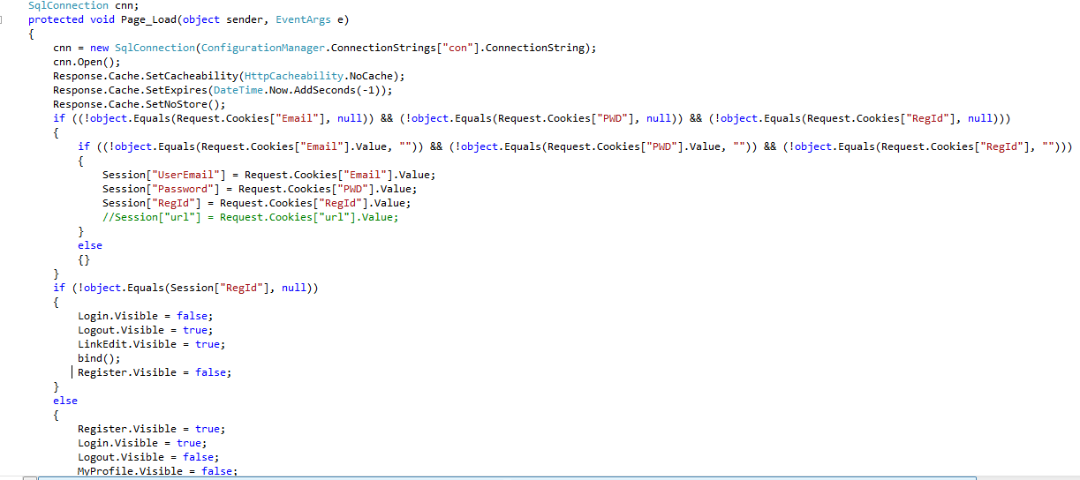
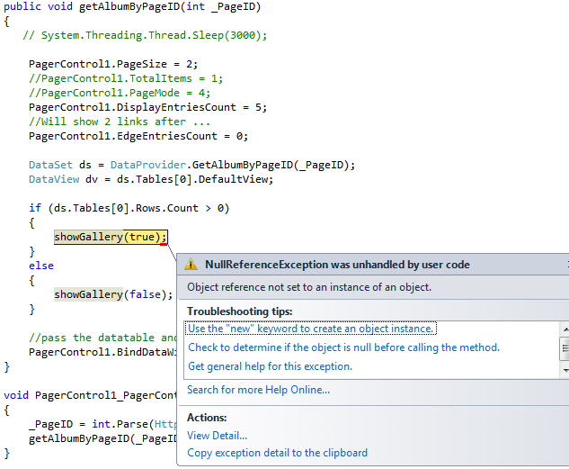
Where are we coming from

Slide 4
MVC
Controller.cs
ViewModel.cs
Model.cs
View .cshtml/.ascx

Slide 5
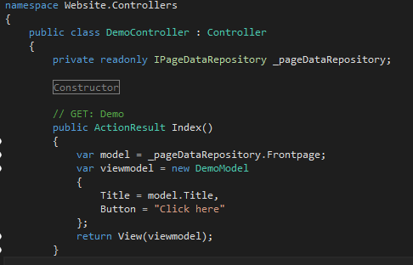
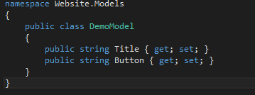
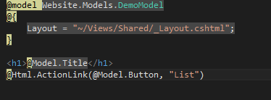
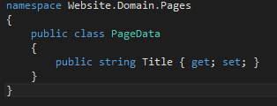
MVC

Slide 6
MVC – an overview
The boring but stuff while you are still awake, before we go to the real code…

Slide 7
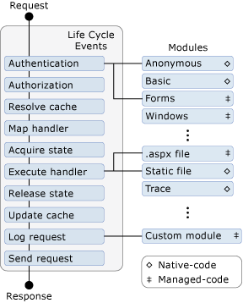
ASP.NET / IIS Request life cycle

Slide 8
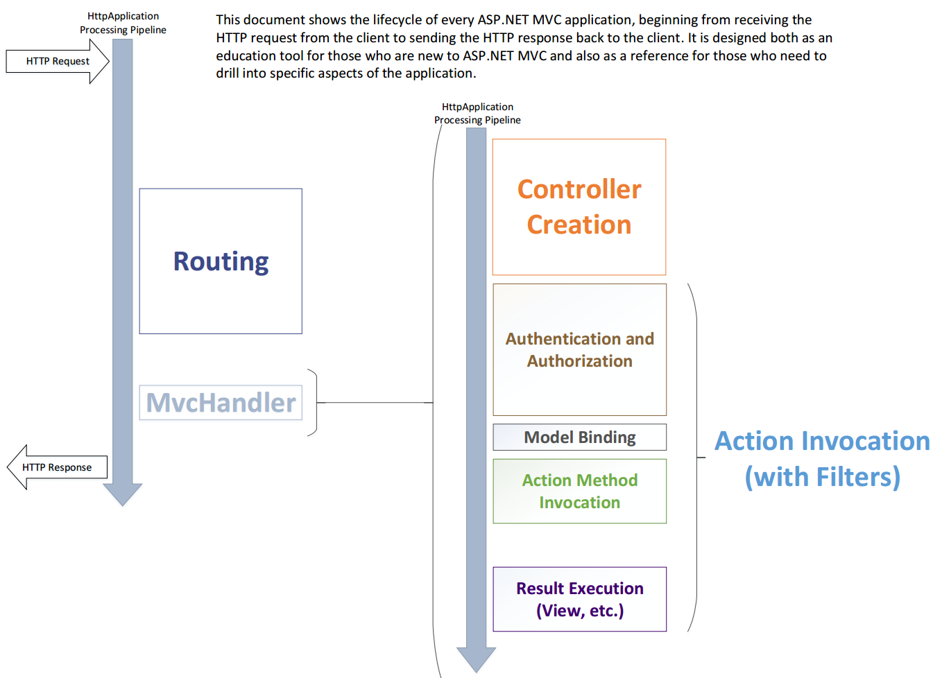

Slide 9
MVC Versions
VS 2008 - Mar 2009
MVC 1
VS 2008/10 - JAN 2011
MVC 3
VS 2010/12 - Aug 2012
MVC 4
Razor
ActionResult
VS 2013 - Aug 2013
MVC 5
ViewBag
IDependency Resolver
Unobtrusive Javascript
Async Controllers
Bundling and minification
DotNetOpenAuth
WebApi
Nicer project templates (empty) ☺
DisplayModes
Mobile focus
Attribute routing
Bootstrap in template
ASP.NET Identity
Authentication Filters
Filter overrides
NuGet!
Open source (MS-PL!)
Routing
HtmlHelper + Extension methods
Conventions

Slide 10
Now let’s see some code

Slide 11
Core MVC features
Controller
Views, ViewEngines
Razor
Page view (ny .aspx)
Partial views (ny .ascx)
Layout.cshtml (ny .master)
Syntax
Html helper
Helpers
Extension methods
Routing
Action filter
Forms
Model binding
Value binding

Slide 12
Action Filters
Authorize
ChildActionOnly
OutputCache
HandleError
RequireHttps
ValidateAntiForgeryToken
ValidateInput (.NET 2.0)
NonAction

Slide 13
MVC extension points
Dependency injection
Global filter
Custom filter
Custom modelbinder
Custom valueprovider

Slide 14
Web API
Similar concept to MVC – routing, controller
Focus on API – not views but result objects
Content negotiation
Use same logic/controller for several formats (xml, json, other)
Extension points
Custom format for content negotiation
Dependency injection (similar to MVC, different namespace)
Global filters (similar to MVC, different namespace)

Slide 15
MVP
Presenter.cs
ViewModel.cs
Model.cs
View.ascx

Slide 16
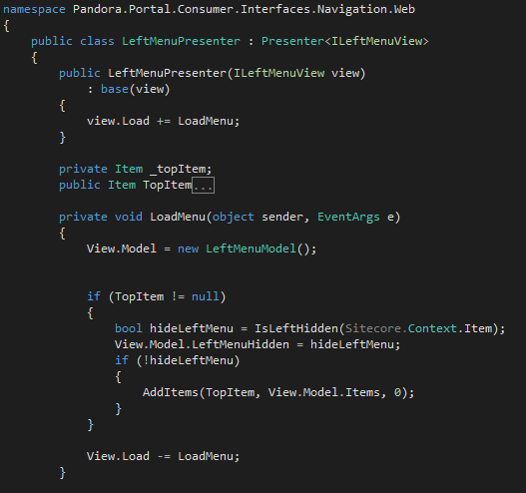
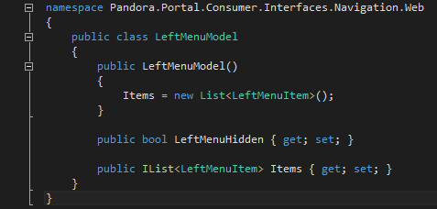
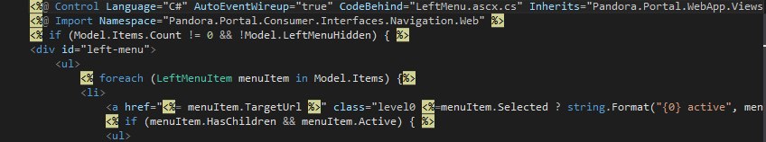
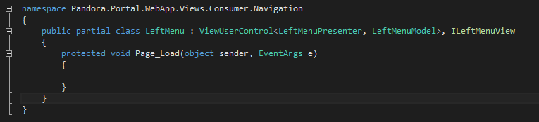
MVP

Slide 17
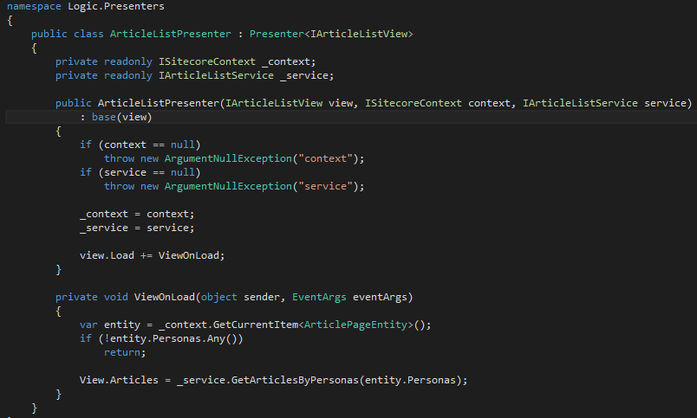

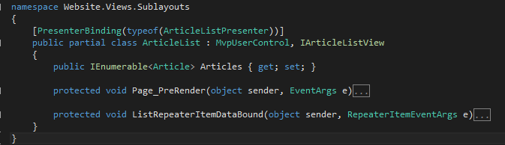
MVP

Slide 18
Launch
(hopefully)

Slide 19
Sitecore and MVC
Supported versions according to Sitecore
6.6, 7.0 – MVC 3 (disabled by default)
7.1 – MVC 4 (disabled by default)
7.2, 7.5 – MVC 5.1
Two ways
Native way – two completely seperated worlds
Automatic way – integrated in Sitecore
Cannot mix Webforms and MVC (no sublayout nor WebControl)

Slide 20
Sitecore and MVC
Sitecore tweaks
Presentation details (master/layout, several renderings) – ”the automatic way”
Routing
Form post
Enhancements
Model/View renderings – SitecoreController
Support Page Editor – rendering pipeline - SitecoreHtmlHelper

Slide 21
Sitecore and MVC
Renderings: View rendering, Controller rendering, Item rendering
Model
Pipelines
Initialize
httpRequest
MVC specific
RequestBegin
CreateController
GetPageItem, BuildPageDefinition, GetPageRendering, GetRenderer, GetModel
RenderRendering, RenderPlaceholder
Some others…

Slide 22
Let’s see some code

Slide 23
Sitecore MVC and POST
Posting
Use ajax and a Web API controller
Use @Html.Sitecore().FormHandler()
Remember model validation – handle invalid Model (SitecoreController’s DefaultAction or Redirect())

Slide 24
Sitecore and the real world – Codehouse way
Prefer static typed models
Always prepare for unit testing

Slide 25
Sitecore and the real world – Codehouse way
Static types -> Domain models and mapping – Glass Mapper
Wrap context?
Use WebApplication – compile assembly and deploy

Slide 26
References
SDN:
http://sdn.sitecore.net/upload/sitecore7/72/sitecore_mvc_developer_guide_72-a4.pdf
Sitecore and MVC:
http://www.slideshare.net/ruudvanfalier/sitecore-mvc-user-group-conference-may-23rd-2014
Posting:
http://mhwelander.net/2014/05/28/posting-forms-in-sitecore-mvc-part-1-view-renderings/
http://mhwelander.net/2014/06/16/supporting-field-parameters-with-sitecore-mvc/
http://brad-christie.com/blog/2014/09/24/using-data-attributes-with-sitecore-mvc/

Slide 27
Questions?
Codehouse A/S | Amerikavej 15 B | 1756 København V
Tlf. (+45) 70 25 75 25 | info@codehouse.com | www.codehouse.com

Slide 28

Codehouse A/S | Amerikavej 15 C, 2. | DK-1756 København K | Tlf. (+45) 70 25 75 25 | info@codehouse.dk | www.codehouse.dk

